Slide 1



Come see your SQL Perfmon in the cloud
#azuresql
Bob Ward, Principal Architect
Dimitri Furman, Principal PM
SQL
aka.ms/bobwardms

Slide 2
Agenda
aka.ms/dbwatcher
A new monitoring solution for Azure SQL
How it works
Beyond the dashboards: SQL monitoring data in-depth
Price, roadmap, and timeline
Final Q&A

Slide 3




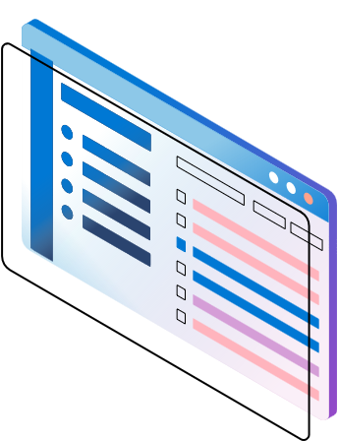
Monitor all Azure SQL DB and Azure SQL Managed Instance workloads
Database watcher
Fully managed
Comprehensive monitoring data
Configurable
Near-realtime latency
Dashboards in Azure portal

Slide 4
This wasn’t easy in Azure SQL before…
Hotspots and outliers across the estate
CPU, Data IO, Log IO, workers
Top queries across the estate
Rank by any Query Store metric
Common SQL perf metrics in one place
CPU, Data IO, Log IO, workers
Current and historical
Table and index metadata
Index suggestions
Backup and SQL Agent job history
Job history
Backup history and statistics
Properties and configuration
Detect configuration drift
Find misconfigured servers and databases
Requests, waits
IOPS, throughput, latency
Connectivity probes
Filter by server, database, query hash, query text
Requests and waits over time
Perf counters: query processing, memory, replicas, etc.
Query activity and session statistics
Blocking chains
Session wait stats
Index usage
Schema details
Job state

Slide 5









A closer look
Pools, serverless, Hyperscale, replicas
Azure SQL Database and
Azure SQL Managed Instance
Targets
Remote Data Collection
Microsoft managed data collection agent
10-20 datasets per target type,
derived from 70+ system views
Data Sources
Authentication
Entra or SQL with key vault secrets
Connectivity
Private Link or Firewall/NSG
Dashboards
Single pane of glass or detailed
Data Store
Azure Data Explorer (including free ADX) or
Fabric Real-Time Analytics

Slide 6
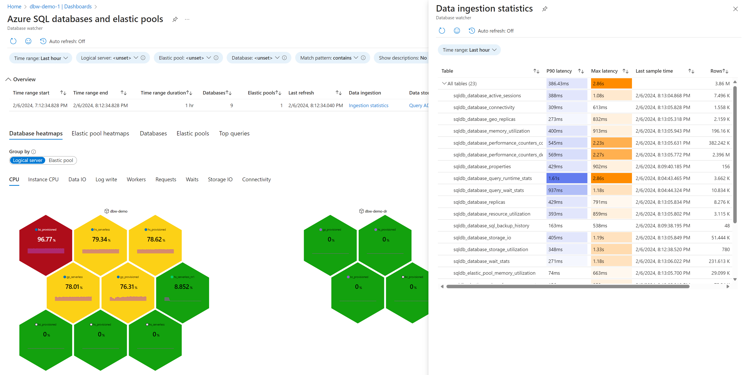
Demo
Database watcher estate dashboards

Slide 7
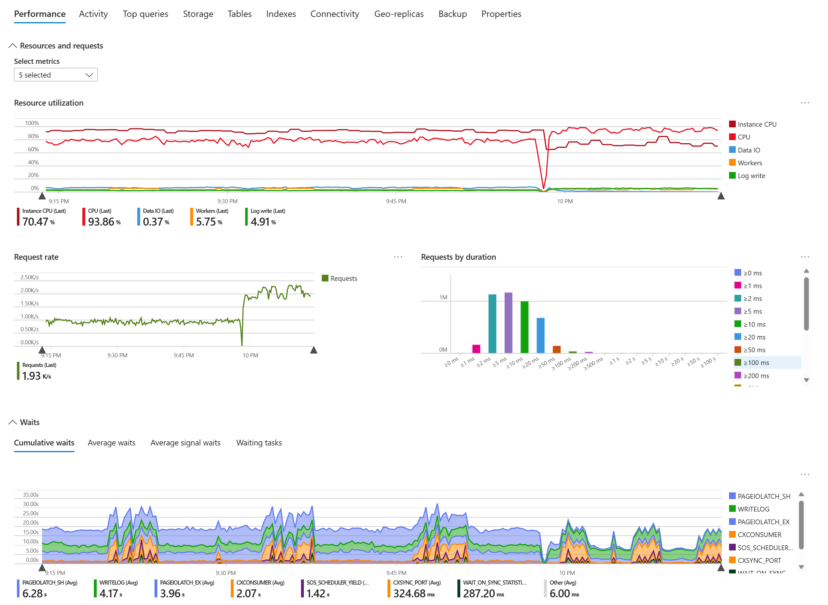
Demo
Database watcher detailed dashboards

Slide 8




How it works
Watcher
Azure SQL estate
Identity
Data store
Targets
Private endpoints
Data store

Slide 9
Network and data access
Principles
Customers fully control network connectivity and SQL permissions
Require minimal access to customer databases
Validate that only the necessary access is granted
Private connectivity
Watcher uses managed private endpoints
Resource owner approves/rejects/deletes each private endpoint
SQL permissions
SQL Database | SQL Managed Instance
Membership in server roles: ##MS_DatabaseConnector## ##MS_ServerPerformanceStateReader## ##MS_DefinitionReader## | CONNECT SQL CONNECT ANY DATABASE VIEW ANY DATABASE VIEW ANY DEFINITION VIEW SERVER PERFORMANCE STATE SELECT on specific tables in MSDB

Slide 10
Dataset categories
Active sessions
Connections, sessions, requests
Backup history
CDC, change feed
Network connectivity
Performance counters
200+ in total
Query Store
Query runtime statistics and wait categories
Replica health
Availability groups, secondary replicas
Resource utilization
CPU, Data IO, Log IO, workers, …
Properties and configuration
Server and database level
SQL Agent
Job state and history
Storage IO
IOPS, throughput, latency
Storage utilization
Volume and database file level
Tables Metadata, schema, size
Wait statistics
Memory utilization
Memory clerks, out-of-memory events
Geo-replication
Missing indexes
Session statistics
Indexes Metadata, operational stats
… and more to come

Slide 11
Using Kusto for SQL monitoring data
Highly scalable
A single Kusto database can support thousands of SQL monitoring targets
Time-proven as a telemetry data store
Optimized for time-series data and analytics
Columnstore
Streaming ingestion for low latency
Short learning curve for SQL professionals
Uses relational database concepts
Powerful KQL language
Has T-SQL support at protocol level
Can offload data to a SQL database or Azure storage on a schedule
Configurable data retention per database and per table
Vertical and horizontal scaling, manual scale or auto-scale, pause/resume

Slide 12
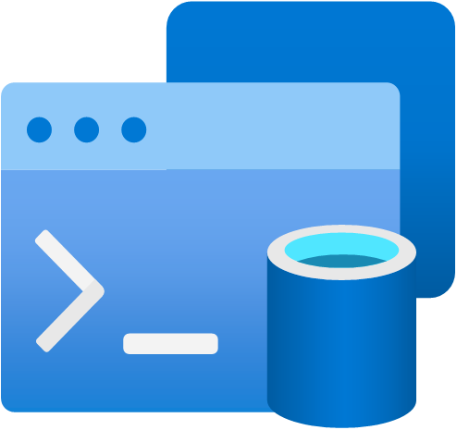
Demo
Analyze monitoring data in KQL and T-SQL

Slide 13
Price
Free
Watchers
Dashboards
No per instance/database/elastic pool/user cost
Paid
Azure Data Explorer compute and storage
Key Vault, if used
Can use an existing cluster
Can use the free cluster for evaluations and POCs
Or use Real-Time Analytics in Microsoft Fabric
Azure network bandwidth for cross-region monitoring

Slide 14
Feature roadmap
Alerts
Monitor SQL Server on Azure IaaS VM
Increase the number of SQL targets per watcher
Improve manageability
Under consideration
Extended event collection
Configurable data collection
PowerShell
Azure CLI
…
Large estates: monitor everything on a logical server, resource group, subscription

Slide 15
Timeline
Private preview
Q2 2023
Public preview
Q1 2024
GA Q4 2024*
✅
✅
* GA timeline depends on public preview feedback

Slide 16
Learn more and send feedback
aka.ms/bobwardms
https://aka.ms/sqlfeedback
Email
Post under the Azure SQL group
Include dbwatcher in the title
dbwatcherfeedback@microsoft.com
Documentation - aka.ms/dbwatcher
Overview
Quickstart
Create and configure
Data collection and datasets
Analyze monitoring data
FAQ

Slide 17

Session feedback
https://sqlb.it/?12745

